Slide 1


Product: Senior Wellness
Authored by the team:
Sai Tarun Kovelamudi
Aishwarya Borde
FAPM401 – Capstone Project
Agile Product Management

Slide 2
Problem Statement
As a senior citizen living independently, I face challenges in monitoring and maintaining my health while staying connected to my loved ones and caregivers. I am seeking a technology solution that can help me track my health metrics effortlessly and provide crucial information to my family or caretaker in real-time.
Moreover, I desire a system that can alert my family or caretaker immediately in case of any abnormal health readings or potential emergencies, like a sudden heart issue or a fall. Having this functionality would provide me with an added sense of security and reassurance, knowing that help can reach me promptly if needed.

Slide 3
Problem Statement
As a caretaker responsible for the well-being of my parents, I am deeply concerned about their health and safety while they live independently. I am seeking a reliable and user-friendly technology solution that can assist me in monitoring their health conditions remotely and promptly responding to any emergencies that may arise.
Currently, I face challenges in staying connected with my parents and accessing real-time health information. I desire a comprehensive solution that allows me to keep track of their health metrics, including step count, oxygen level, blood pressure, and other vital signs, without causing them any inconvenience.

Slide 4
Vision Statement
Our vision is to create a revolutionary smartwatch along with a mobile application that serves as a dedicated health companion for senior citizens, empowering them to lead independent and active lives while providing their caretakers with real-time insights into their well-being. By seamlessly integrating advanced health monitoring technology with user-friendly features, our smartwatch aims to become the go-to solution for enhancing the safety, health, and overall quality of life for seniors and offering their caretakers unparalleled peace of mind. We envision a future where our smartwatch along with the mobile application acts as a reliable bridge between senior citizens and their loved ones, ensuring timely assistance during emergencies and fostering a sense of security and connection, enabling seniors to age gracefully while staying effortlessly connected with their support network.

Slide 5
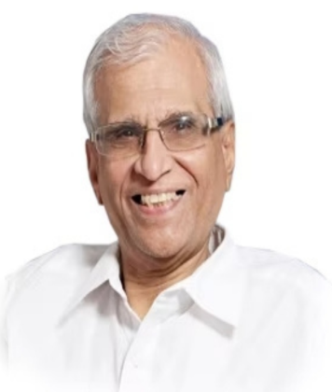
USER PERSONA - SENIOR CITIZEN
Bio
Mr. Raja is a 63-year-old retired accountant who lives in a quiet suburban neighborhood with his wife of 60 years,
He suffers from diabetes. He walks daily and eats healthy. He wants to monitor his health regularly, so if he is interested in using a smartwatch, he may want to consider one that is designed specifically for seniors and offers features such as fall detection and emergency alerts.
Pain points
Assistance in case of emergencies or occasional support is needed.
Keeping a log of blood sugar levels regularly after check-up.
Checking the health parameters regularly by visiting the doctor.
Behaviours
Raja
Raja takes a proactive approach to his health by monitoring it closely and seeking regular check-ups with his doctor.
He maintains a healthy lifestyle by eating a balanced diet, exercising regularly, and getting enough sleep.
He tracks his exercise and diet using fitness tracker, to ensure he is meeting his health goals.
Age
63
Gender
Male
Status
Married
Goals and Aspirations
To track physical activity and monitor heart rate, BP, Sleep, sugar level & other health parameters.
Utilising wearable technology to monitor health.
Assistance from someone in case of an emergency situations.
Alerting nearby relatives or partner or emergency services during emergency could be lifesaving.
Location
Hyderabad

Slide 6
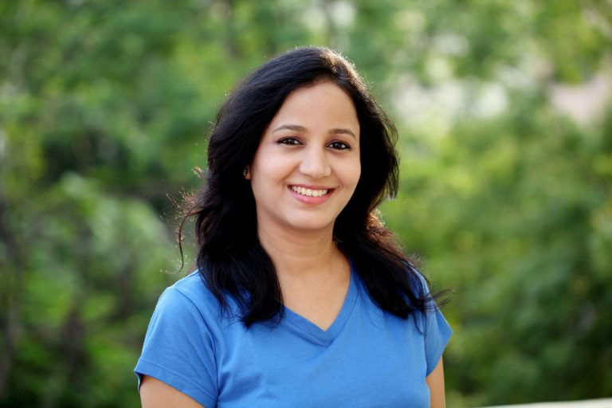
User Persona
Bio:
Sarah is a 30-year-old professional who works in a busy corporate job. She is the only child of her elderly parents. Despite her busy schedule, Sarah deeply cares for her parents' well-being and takes on the role of their primary caregiver. She lives in the same city as her parents and visits them regularly, but due to her work commitments, she cannot be with them all the time. Sarah is tech-savvy and often relies on technology to streamline her daily tasks.
Pain Points:
Time Constraints: Due to her demanding job, Sarah struggles to be physically present with her parents all the time, which can lead to worries about their well-being when she's away.
Health Monitoring: Sarah is concerned about her parents' health conditions, especially as they grow older. She wishes to have real-time access to their health metrics to detect any potential health issues promptly.
Emergency Response: Sarah worries about her parents experiencing an unexpected health emergency, such as a fall or heart attack, when she's not around to assist them.
Sarah
Behavior:
Sarah is proactive and organized when it comes to her caregiving responsibilities. She ensures that her parents have all the necessary resources and support to lead a comfortable life.
Age
30
Gender
Female
Status
Unmarried
Goals and Aspirations:
Sarah's primary goal is to ensure her parents' safety, health, and happiness. She aspires to provide them with the best possible care and support, allowing them to maintain their independence for as long as possible. Sarah also wants to strike a balance between her work and personal lives, ensuring she can spend quality time with her parents and also take care of her own well-being.
Location
Hyderabad

Slide 7
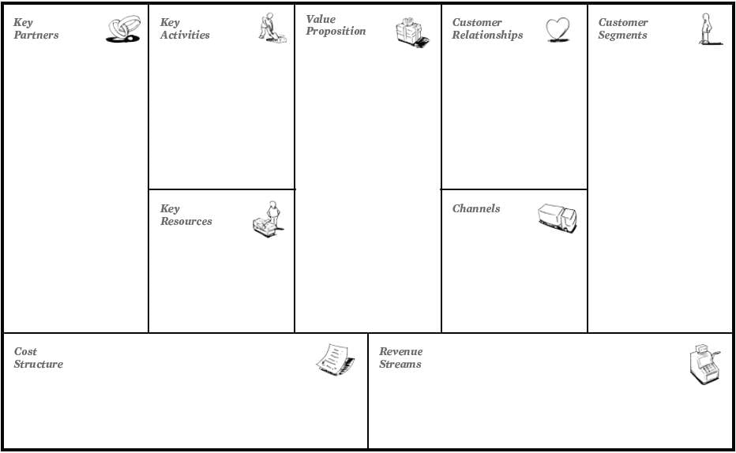
The Business Model Canvas
1. Investors
2. Ad agencies
3. Smart watch manufacturers
4. Marketing & Sales
1. App Design
2. App Development
3. Smart watch
4. Integration
5. Launch the product
6. Marketing
7. Sales
1. Smartwatch + mobile app that seamlessly syncs data with good user experience.
2. The smartwatch should track health and fitness metrics.
3. The mobile application should enable users to get notified and view data.
4. A smart watch + App users will have Improved health outcomes.
5. It has an intelligence of Fall detection & alerts, users can enhance their quality of life.
1. Service
2. Smart watch offers
3. Subscription model
Target customer segments are :
1. Senior citizens
2. Their partners
3. Children
4. Relatives
5. Caregivers.
1. Digital & paid ads
2. Social media
3. Marketing
4. Direct sales
1. Tech team
2. PM team
3. Testing team
4. Marketing, Sales team
1. Investment - Platform Maintenance, Office maintenance, Hiring teams, Marketing.
1. Premium membership
2. Advertisements in the application
3. Subscription

Slide 8
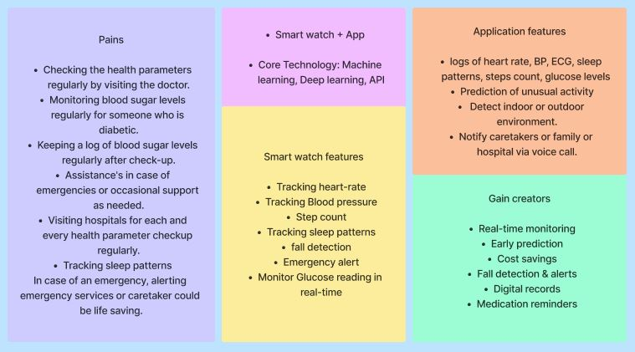
Product Market Fit - Solution

Slide 9
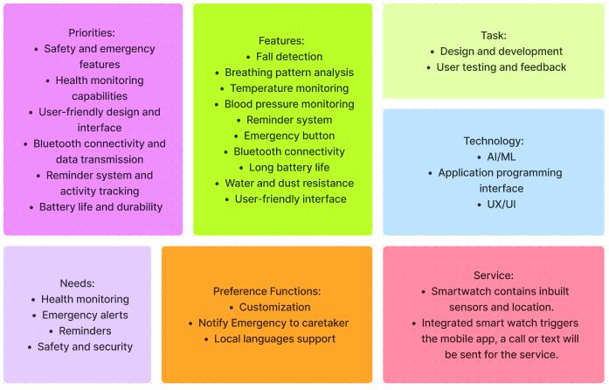
Business Requirements

Slide 10
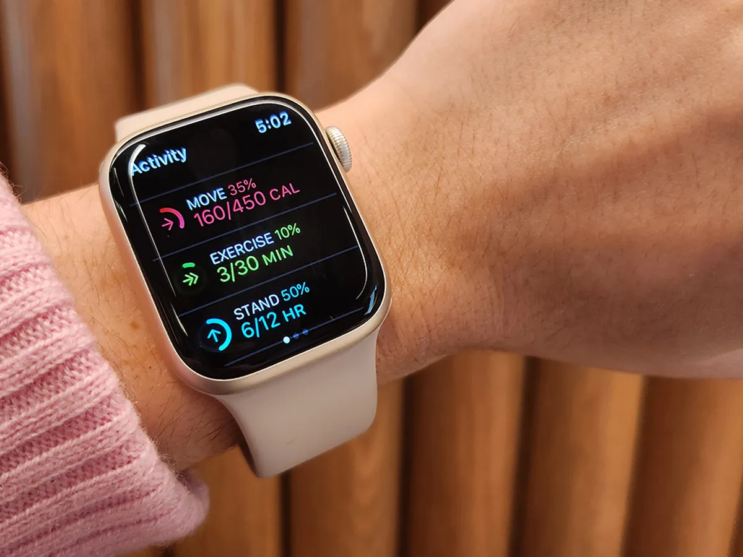
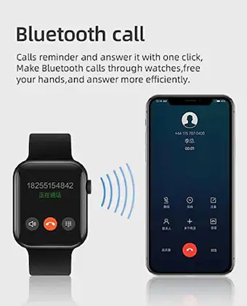
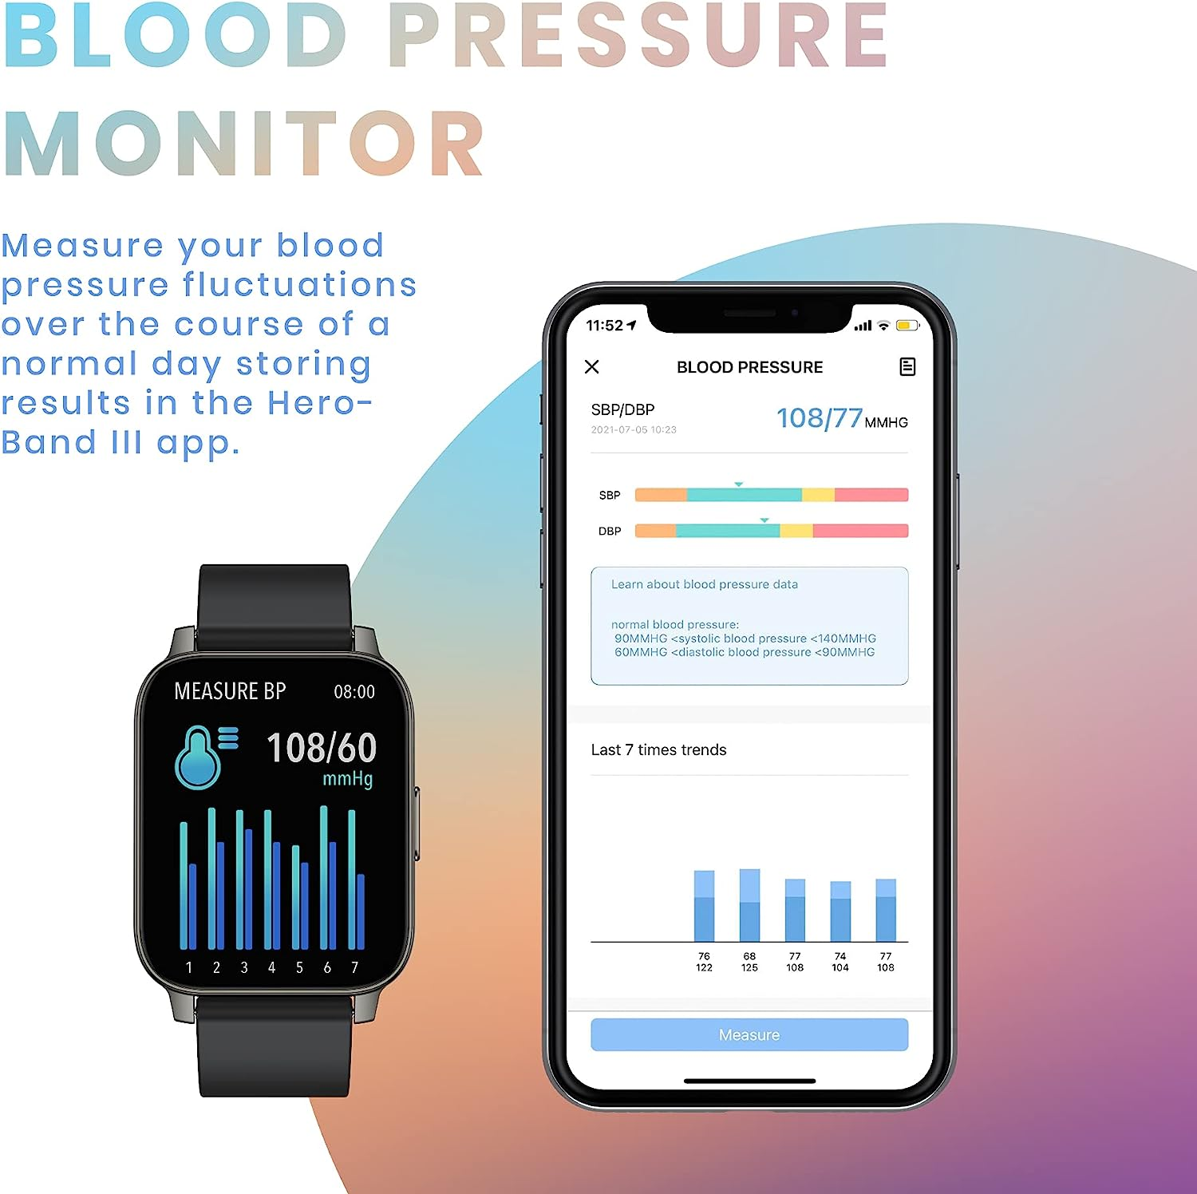
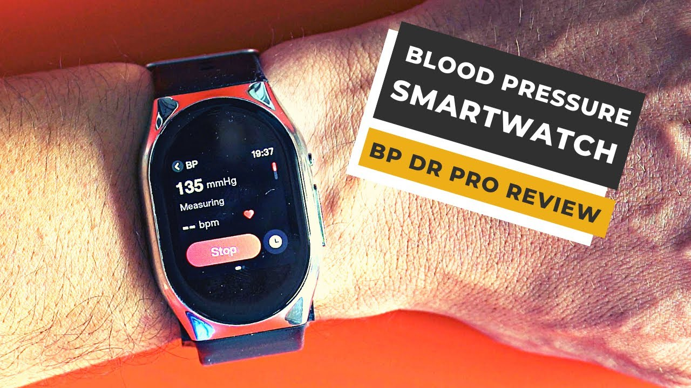
Technology Requirements
Software development kit (SDK) or API for app integration and customization.
AI/ML for health care predictions.
After fall detection, images will run through the Computer vision technology to detect the indoor or outdoor environment.
Top notch UX/UI for customer satisfaction.
Bluetooth smartwatch for seamless connection with mobile devices.
Sensors for accurate breathing pattern analysis.
Temperature sensor for measuring body temperature.
Blood pressure monitoring sensor capability.
Long-lasting battery technology for extended usage.
Water and dust resistance technology for durability.
Compatibility with mobile operating systems. (e.g., iOS, Android)
Firmware update capability for future enhancements and bug fixes.
Reliable wireless communication protocols for data transmission.
Compatibility with various mobile devices and operating system versions.
Data encryption and secure transmission to protect user privacy.
Compatibility with healthcare and monitoring apps for data integration.

Slide 11
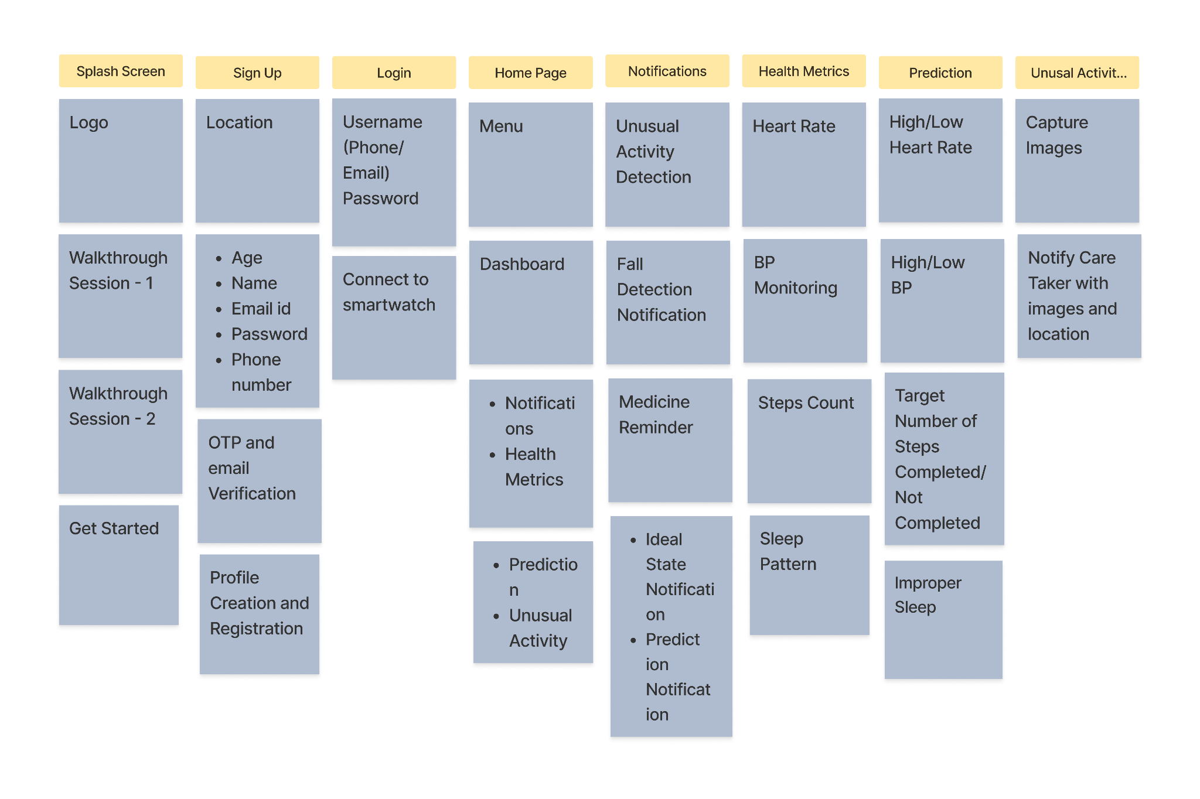
Card Sorting

Slide 12
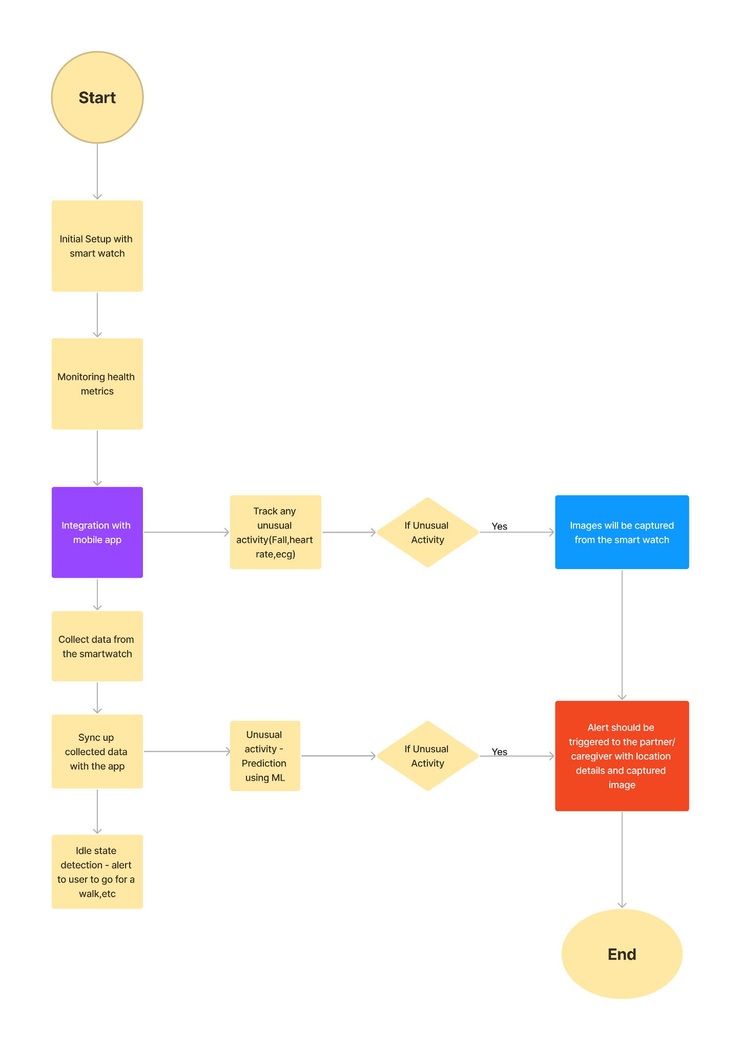

Interaction / User Flow

Slide 13
USER FLOW

Slide 14
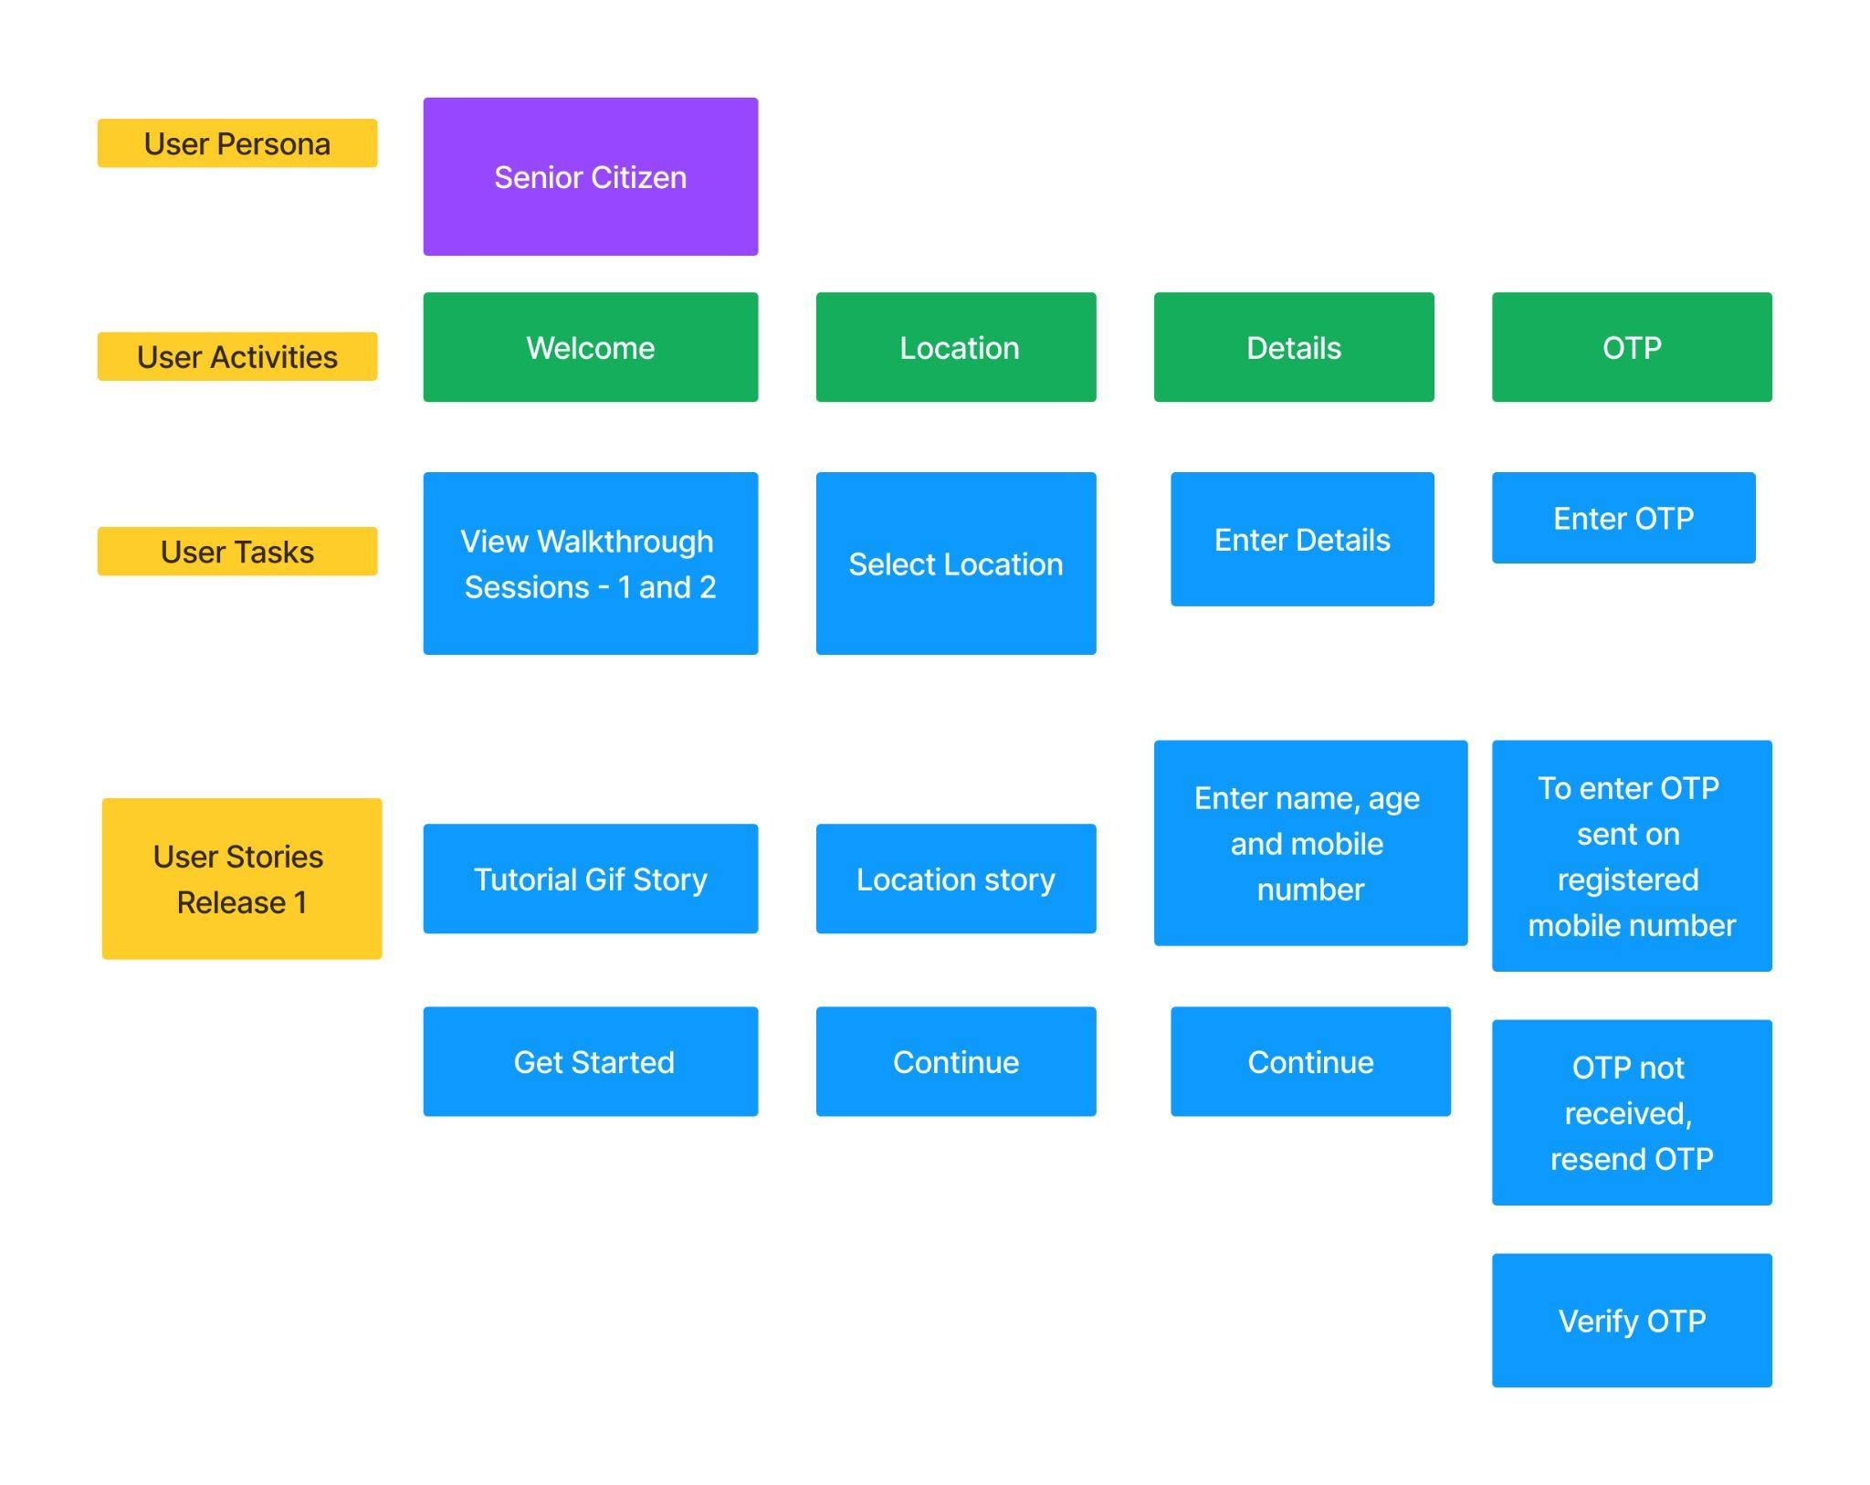
Story Mapping

Slide 15
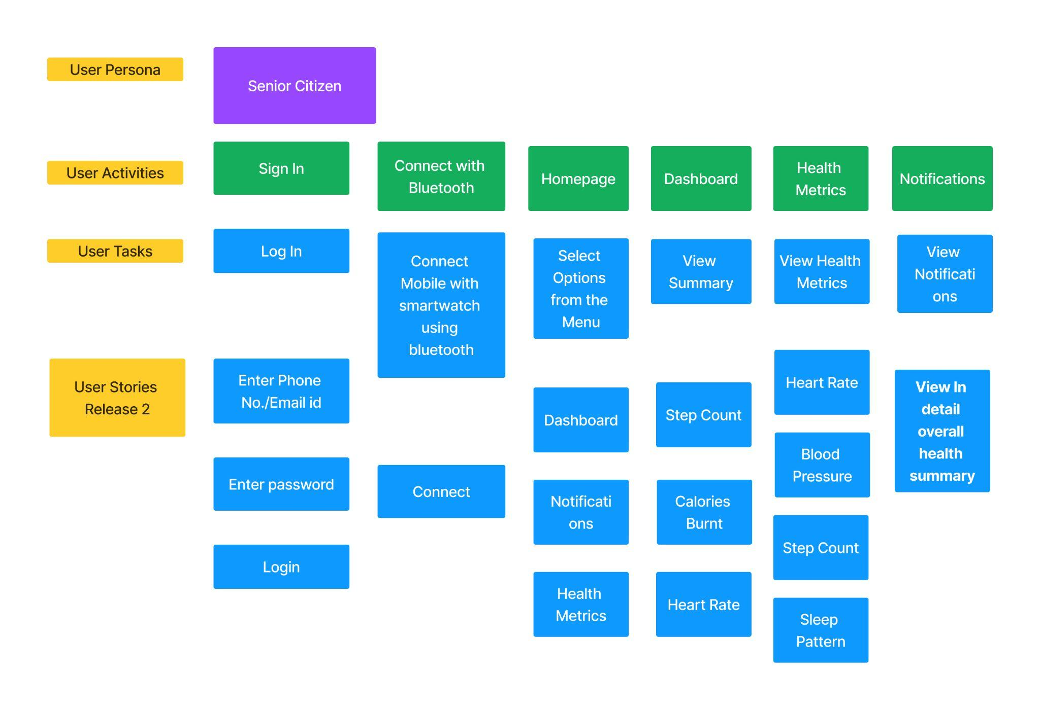
Story Mapping

Slide 16

Story Mapping

Slide 17
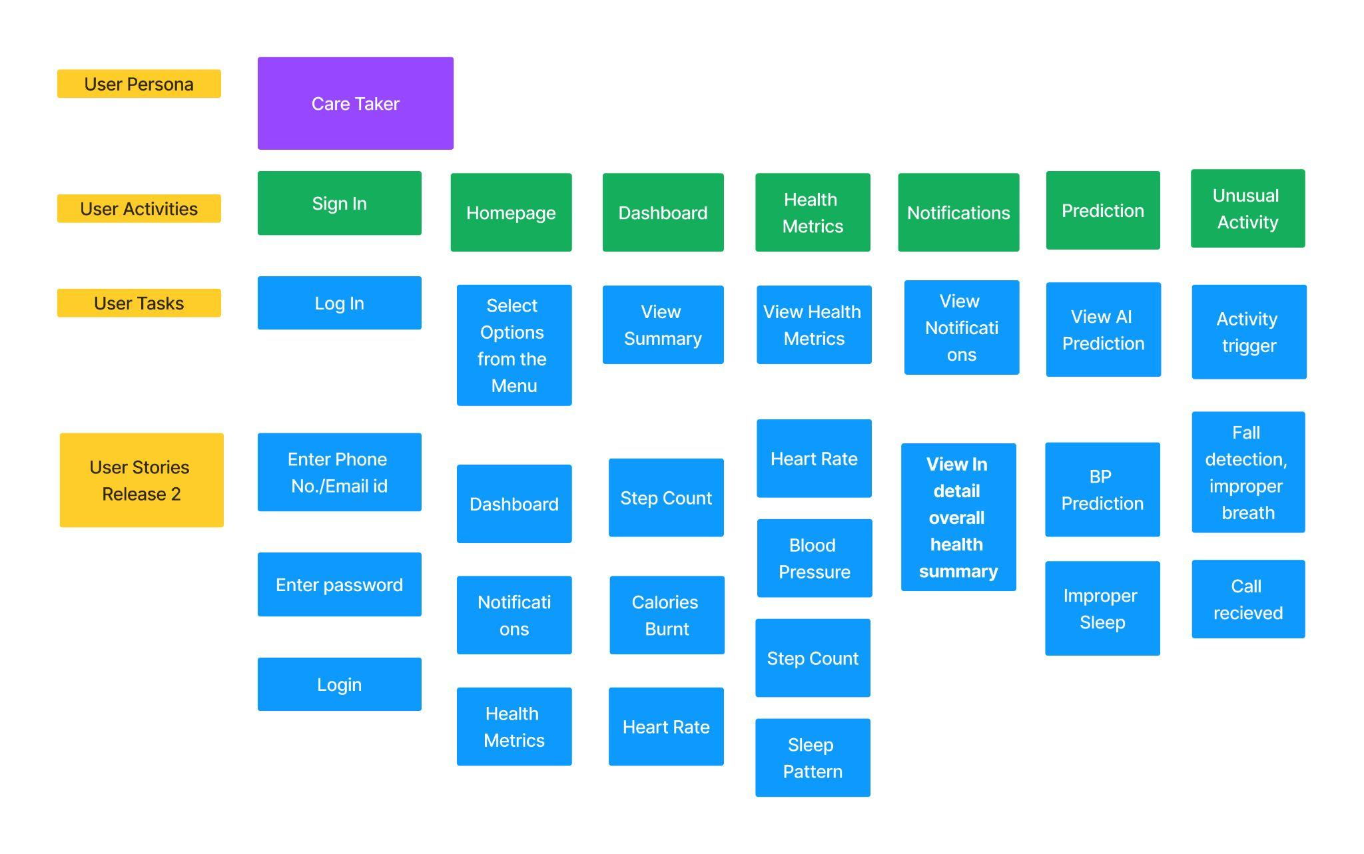
Story Mapping

Slide 18
User Journey
Phases | Connecting the App to Smartwatch | Checking the notifications | Taking actions according to the notifications | In an event of unusual activity, caretaker gets informed | Actions like calling an ambulance, informing doctors triggered at a faster pace
Touch Points | Switch on bluetooth and connect app | Check notifications if any medicine reminders, walk more steps if prompted, etc | Actions to be performed by senior citizen- Drink more water, walk more steps, take medicines. | Smart watch automatically clicks images and sends details like location and images to caretaker. | To Trigger alerts in less time.
Goals | To connect the app and smartwatch | To make the notifications very precise according to the senior citizens health requirements. | To make the senior citizen believe that they need to take actions according to the notifications. | Images should be clicked as soon as the unusual activity is detected. E.g. fall or no movement. | Notifications should be sent out instantly.
Thinking/Feeling | Initially will take time understanding how to connect. | Need to check notifications whenever one pops up on the screen, | Need to develop habits. | Feeling a sense of calm knowing that caretaker has been informed and help will arrive soon.r | Caretakers know the current situation of the senior citizens as soon as anything happens,

Slide 19
User Stories - Senior citizen
ID | Summary | Type | Status | Priority | Points | Description | Acceptance criteria
SWA-01 | Walkthrough Sessions | Story | To do | Medium | 2 | As a senior citizen, I am able to get a walkthrough of the app UI. | User is able to view a welcome screen including the logo. The user will go through 2 walkthrough sessions.
SWA-02 | Location | Story | To do | Medium | 2 | I am able to select my current location. | User is able to select his/her location from the drop down menu. Click on the continue button.
SWA-03 | New user signup | Story | To do | Medium | 2 | As a user, I am able to login using my phone number. | User is able to sign up using phone number. User is able to enter personal details like name and age using the fields provided.
SWA-04 | Enter OTP | Story | To do | Medium | 2 | As a user, I am able to enter the OTP. | User receives OTP on registered mobile number and verifies it by entering the OTP..
SWA-05 | Sign in | Story | To do | Medium | 2 | As a user I am able to login by entering the credentials. | User should be able to enter the phone number or email id, password in the field values, click on the login button.
SWA-06 | Connect to Bluetooth | Story | To do | Medium | 2 | As a user, I am able to connect smart watch with the mobile app. | User should be able to click on the connect button to get connected with the mobile app using the bluetooth.

Slide 20
ID | Summary | Type | Status | Priority | Points | Description | Acceptance criteria
SWA-07 | Home Page | Story | To do | Medium | 2 | As a user, as soon as i login, i should be able to see the home page to select the submenu items from the Menu bar. | User should be able click on the home bar and select the sub menu items: 1.Dashboard 2.Health Metrics 3.Notifications Display submenu icons at the bottom of the page to navigate.
SWA-08 | Dashboard | Story | To do | High | 6 | As a user, as soon as i click on dashboard submenu item, i should be able to see the summary of the health metrics in the dashboard. | User should be able click on the dashboard to view summary: 1.Step count 2.Heart rate 3.Calories burnt Display submenu icons at the bottom of the page to navigate.
SWA-09 | Health Metrics | Story | To do | High | 6 | As a user, if i click on health metrics submenu item, i should be able view the various health metrics in the page. | User should be able click on the health metrics to view metrics: 1.Blood pressure 2.Heart rate 3.Sleep pattern Display submenu icons at the bottom of the page to navigate.
SWA-10 | Notifications | Story | To do | High | 6 | As a user, if i click on notifications submenu item, i should be able to see the notifications in the page. | User should be able click on the notifications to view important notifications: 1.Critical notifications 2.Unusual activity 3.Prediction Display submenu icons at the bottom of the page to navigate.

Slide 21
User Stories - Caretaker
ID | Summary | Type | Status | Priority | Points | Description | Acceptance criteria
SWA -20 | Walkthrough Sessions | Story | To do | Medium | 2 | As a caretaker, I am able to get a walkthrough of the app UI. | User is able to view a welcome screen including the logo. The user will go through two walkthrough sessions.
SWA -21 | Location | Story | To do | Medium | 2 | I am able to select current senior citizen location. | User is able to select his/her location from the drop down menu. Click on the continue button.
SWA -22 | New user signup | Story | To do | Medium | 2 | As a user, I am able to sign up using my phone number and name. | User is able to sign up using phone number. User is able to enter personal details like name and contact number using the fields provided.
SWA -23 | Enter OTP | Story | To do | Medium | 2 | As a user, I am able to enter the OTP. | User receives OTP on registered mobile number and verifies it by entering the OTP.
SWA -24 | Sign in | Story | To do | Medium | 2 | As a user I am able to login by entering the credentials. | User should be able to enter the phone number or email id, password in the field values, click on the login button.

Slide 22
ID | Summary | Type | Status | Priority | Points | Description | Acceptance criteria
SWA -25 | Home Page | Story | To do | Medium | 2 | As a user, as soon as I login, I should be able to see the home page to select the submenu items from the Menu bar. | User should be able click on the home bar and select the sub menu items: 1.Dashboard 2.Health Metrics 3.Notifications 4. Prediction 5. Unusual activity
SWA -26 | Dashboard | Story | To do | High | 6 | As a user, as soon as i click on dashboard submenu item, i should be able to see the summary of the health metrics in the dashboard. | User should be able click on the dashboard to view summary: 1.Step count 2.Heart rate 3.Calories burnt Display submenu icons at the bottom of the page to navigate.
SWA -27 | Health Metrics | Story | To do | High | 6 | As a user, if i click on health metrics submenu item, i should be able view the various health metrics in the page. | User should be able click on the health metrics to view metrics: 1.Blood pressure 2.Heart rate 3.Sleep pattern Display submenu icons at the bottom of the page to navigate.

Slide 23
ID | Summary | Type | Status | Priority | Points | Description | Acceptance criteria
SWA -28 | Notifications | Story | To do | High | 6 | As a user, if i click on notifications submenu item, i should be able to see the notifications in the page. | User should be able click on the notifications to view important notifications: 1.Critical notifications 2.Unusual activity 3.Prediction Display submenu icons at the bottom of the page to navigate.
SWA -29 | Prediction | Story | To do | Medium | 5 | User is able to view the AI predictions. | User can view predictions made by AI 1. High BP Prediction 2. Improper sleep 3. Minor Heartache
SWA -30 | Unusual Activity | Story | To do | Medium | 6 | Alert on detection of any unusual activity. | User is alerted by receiving an immediate call in case the senior citizen experiences any kind of unusual activity like - Fall, increased heart rate.

Slide 24
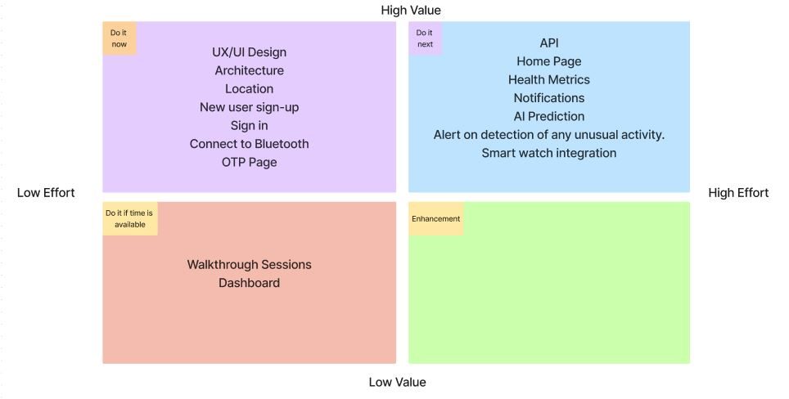
Backlog Prioritization

Slide 25
Roadmap
Month | Activities | Duration
Release 1 | 1. Requirement Gathering and Research - Define user needs and preferences - Conduct competitor analysis - Finalize feature set and specificationS | 2 weeks
 | 2. Hardware and Software Development - Develop the smartwatch hardware components - Implement health monitoring sensors - Build a prototype firmware and software | 3 weeks
Release 2 | 3. Mobile App Development - Design and develop the caretaker's mobile app - Implement real-time data synchronization - Incorporate emergency alert features | 3 weeks
 | 4. Integration and Testing - Integrate the smartwatch with the mobile app - Conduct initial unit and system testing - Address any bugs or issues | 2 weeks
Release 3 | 5. User Testing and Feedback - Select a group of senior citizens and caregivers for testing - Collect feedback and user experience data - Analyze results and make necessary improvements | 2 weeks
 | 6. Final Testing and Quality Assurance - Conduct comprehensive testing and QA checks - Ensure compliance with safety regulations | 1 week

Slide 26
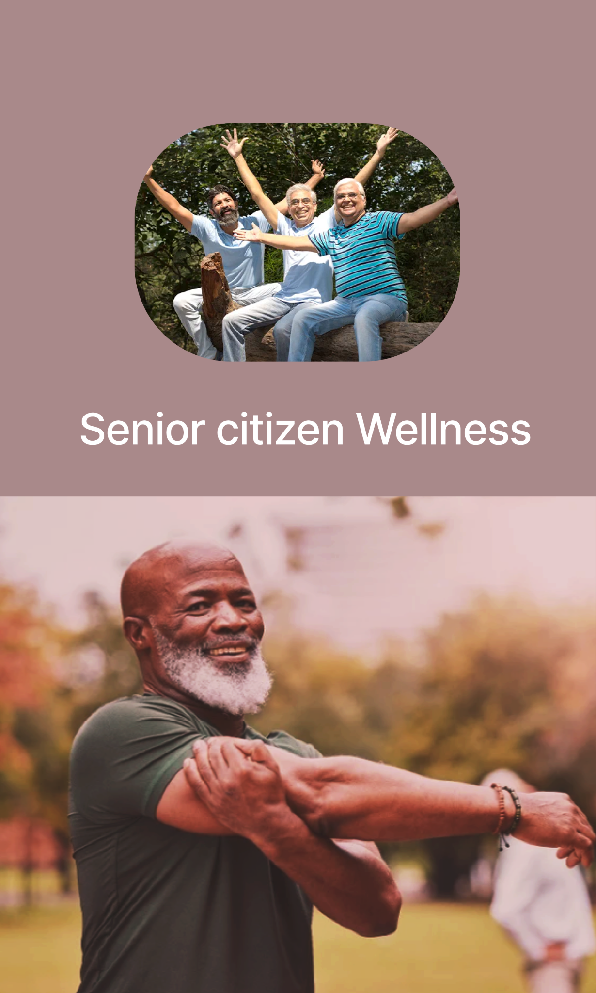
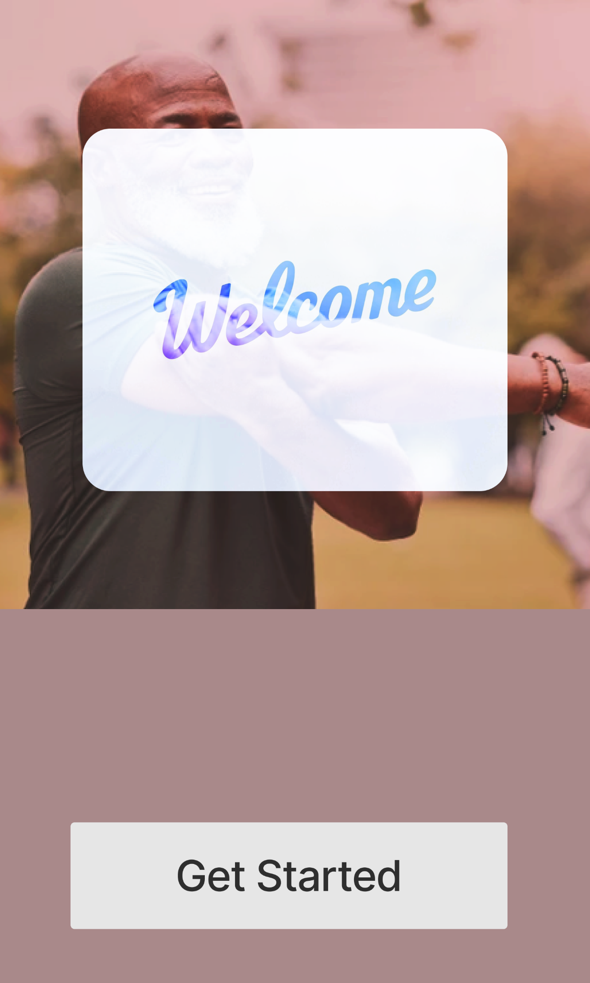
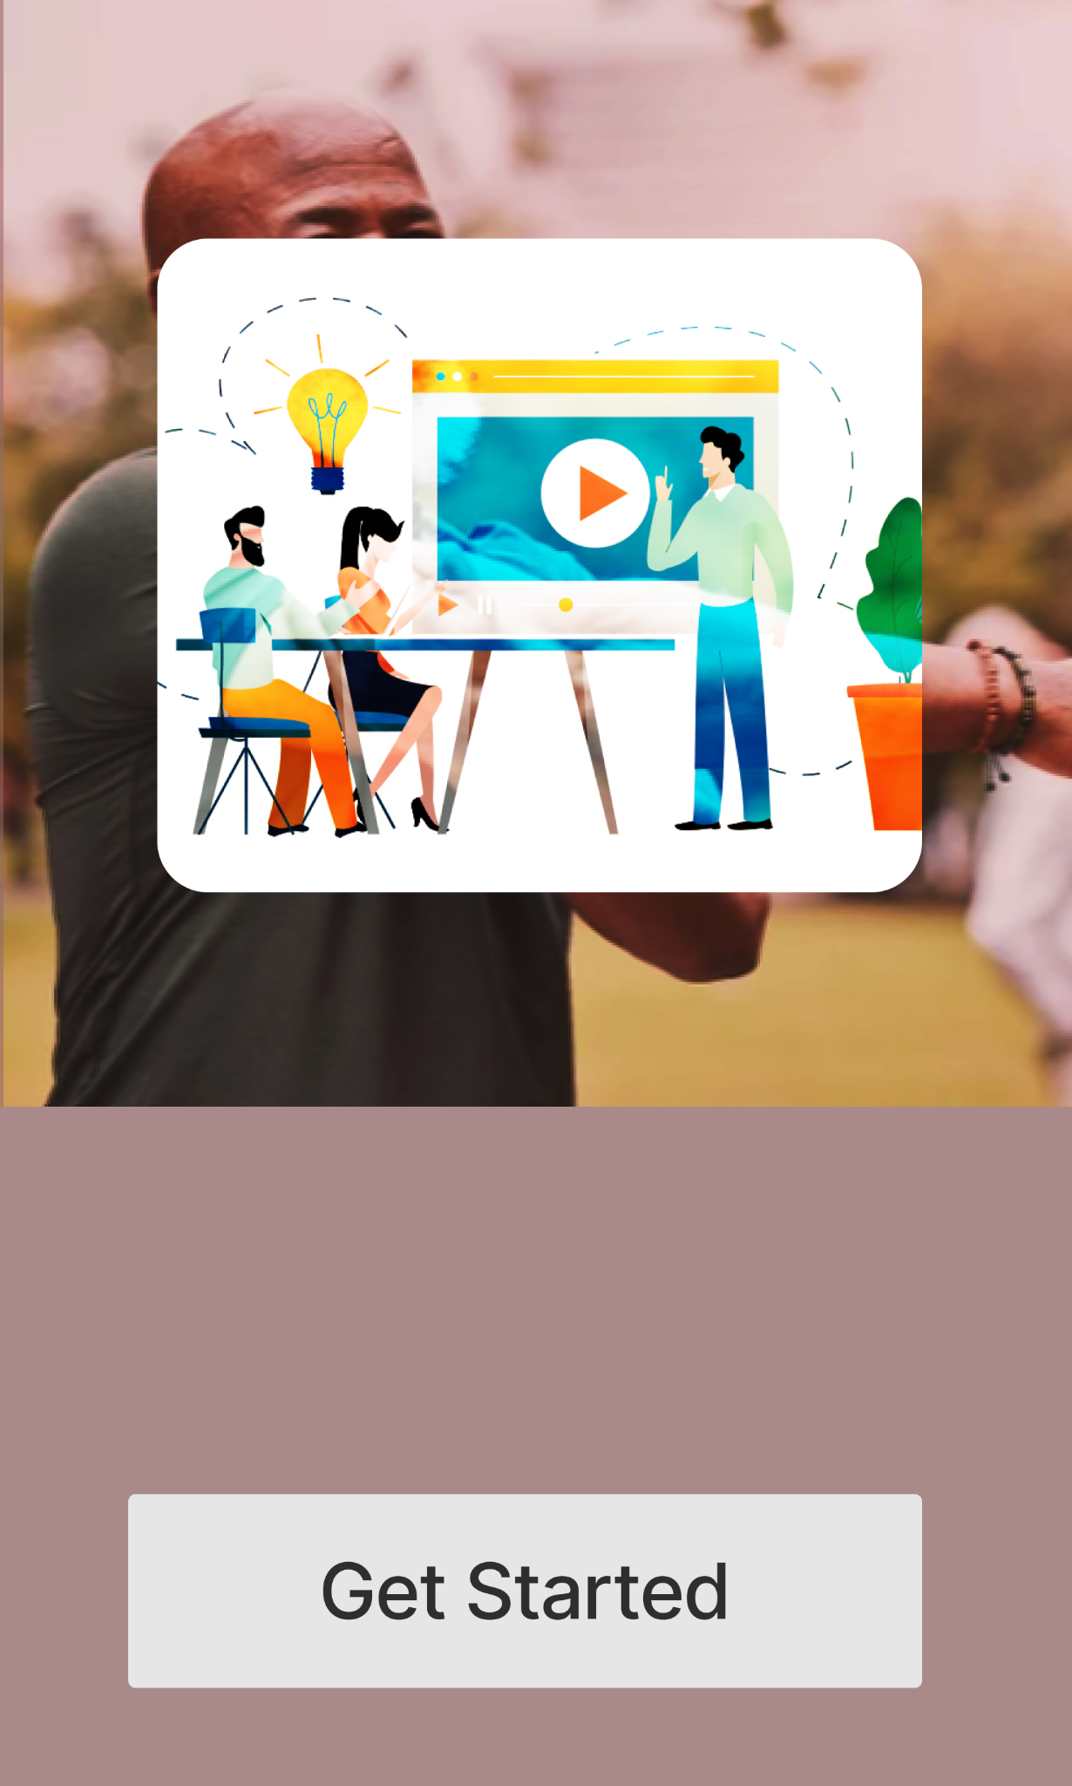
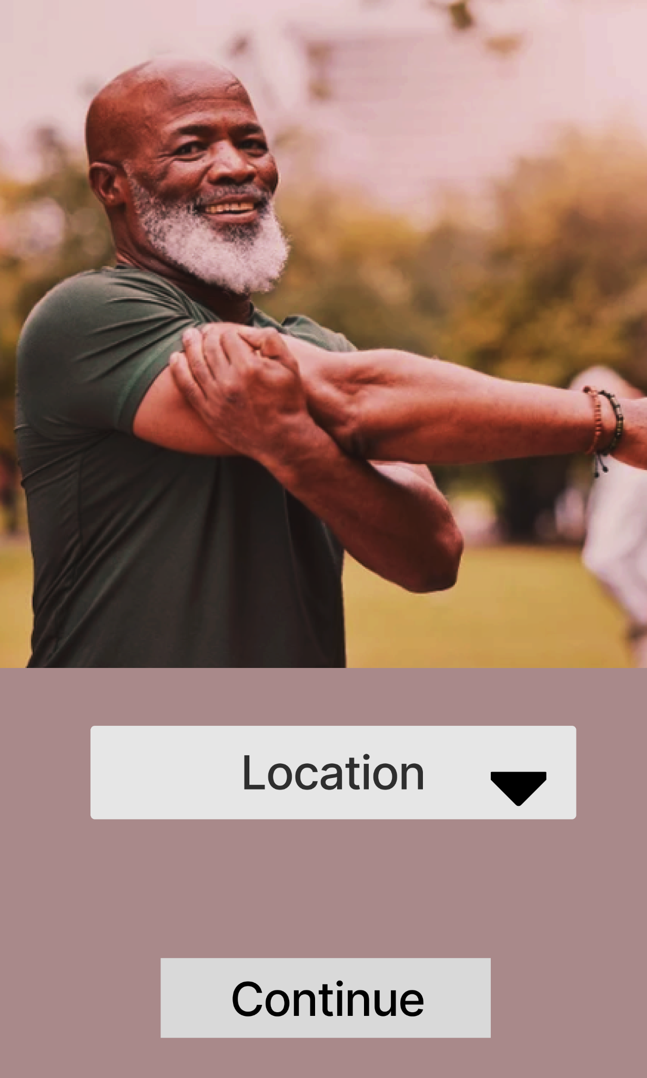
SENIOR WELLNESS APP - MVP
Step 2: Watch the tutorial and click on Get Started
Step 3: Enter location to continue to enter the app
Logo
Step 1: Click on Get Started

Slide 27
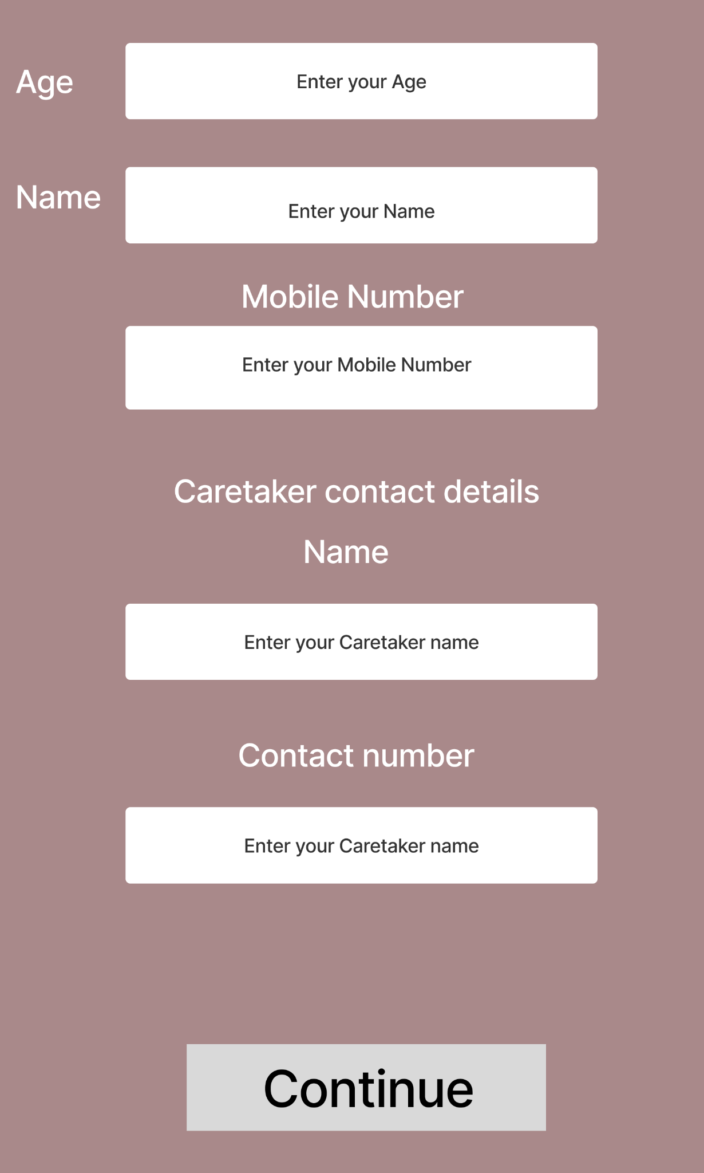
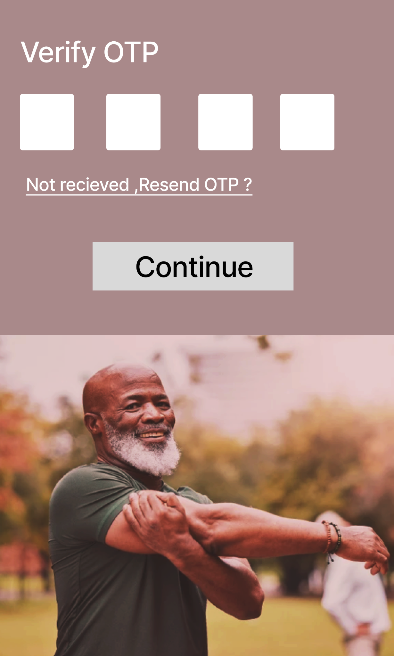
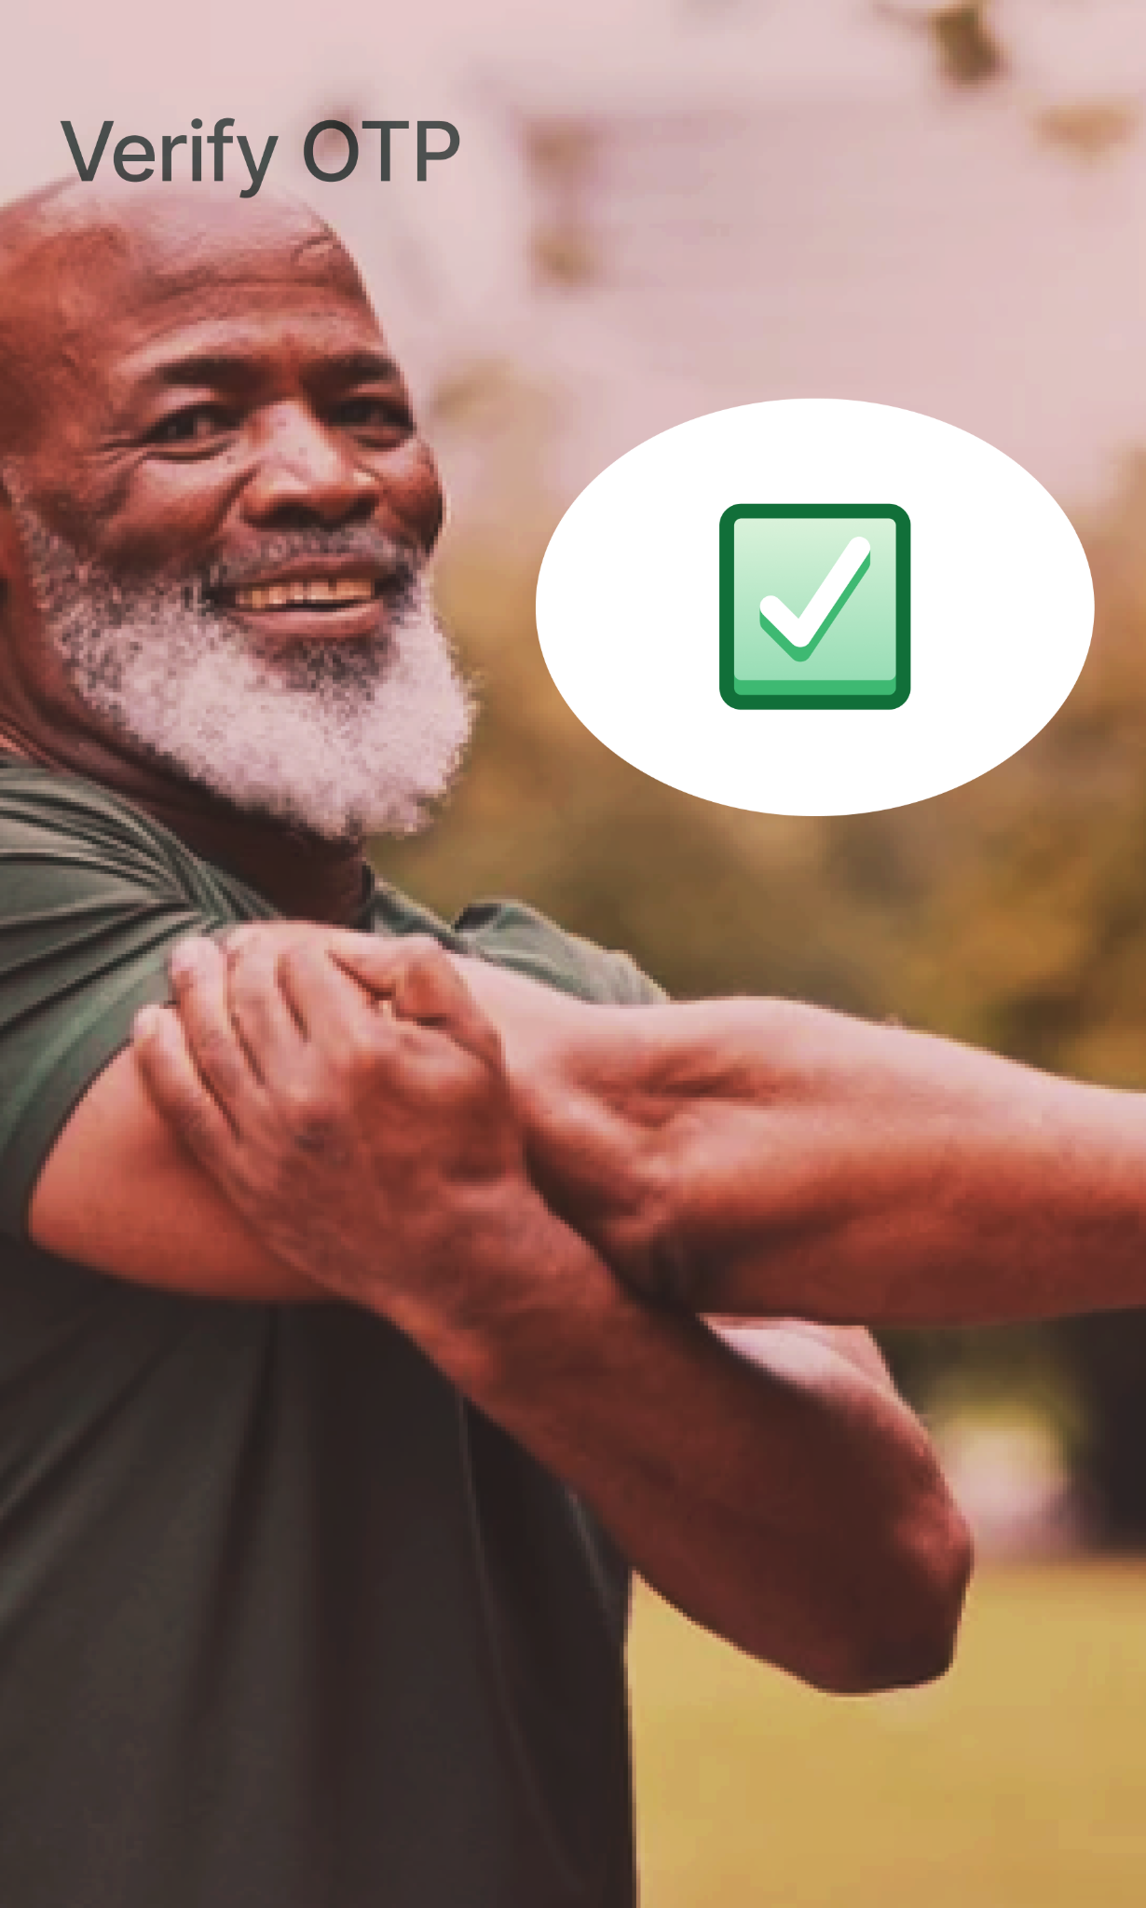
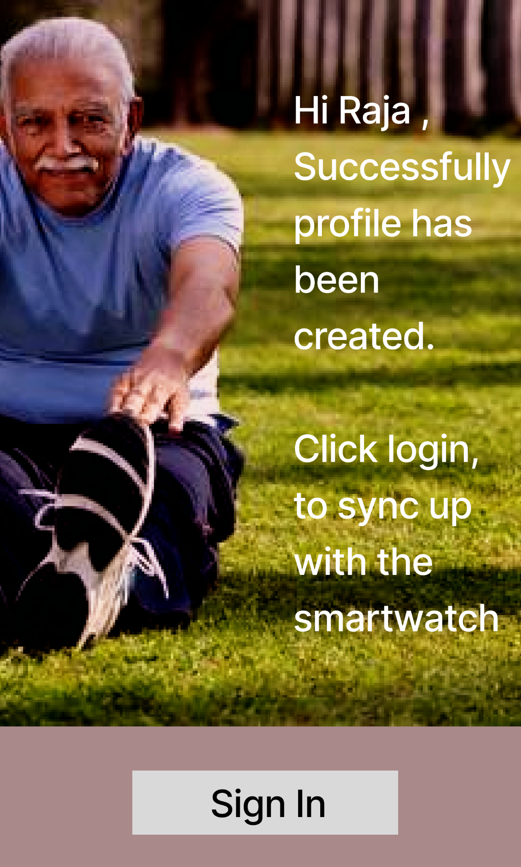
SENIOR WELLNESS APP - MVP
Step 4: Enter the details
Step 5: Enter the OTP received on mobile number to verify.
OTP verified
Step 6: Click Sign In

Slide 28
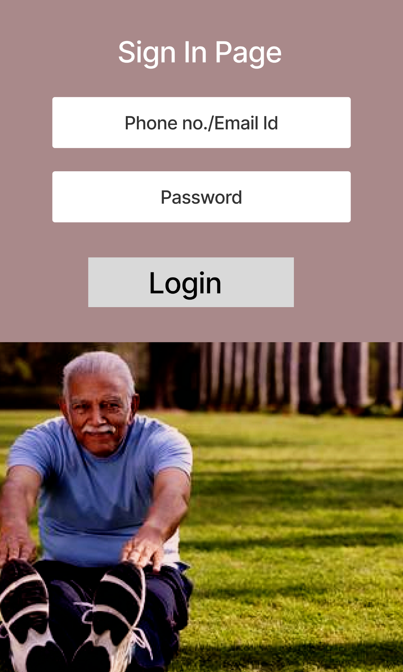
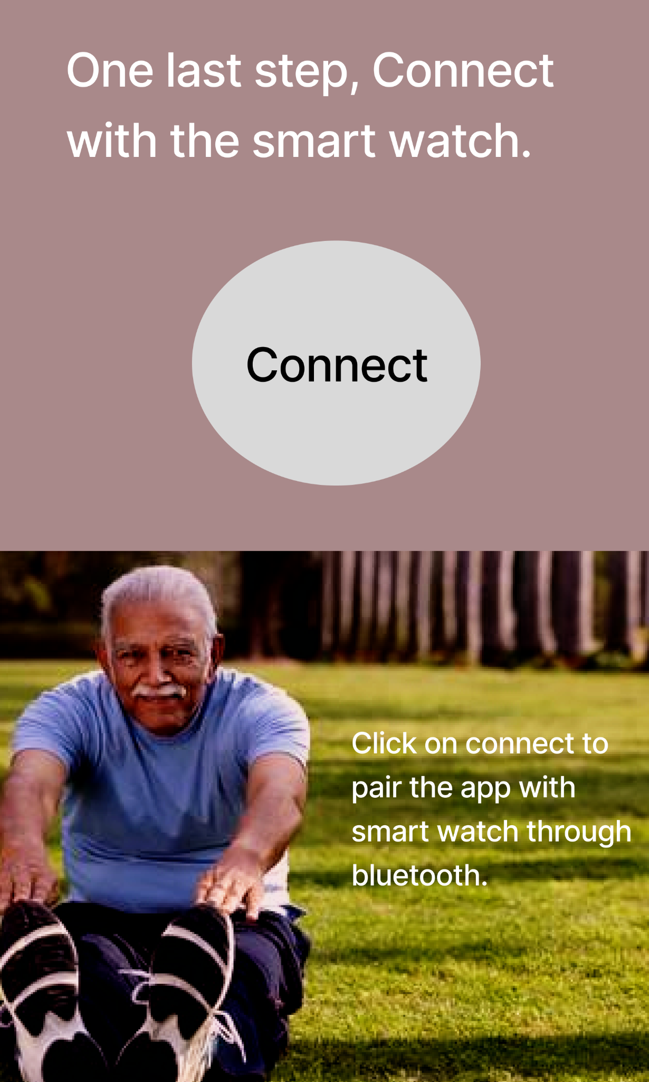
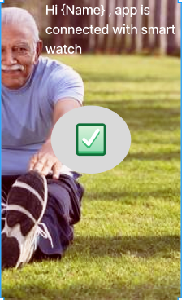
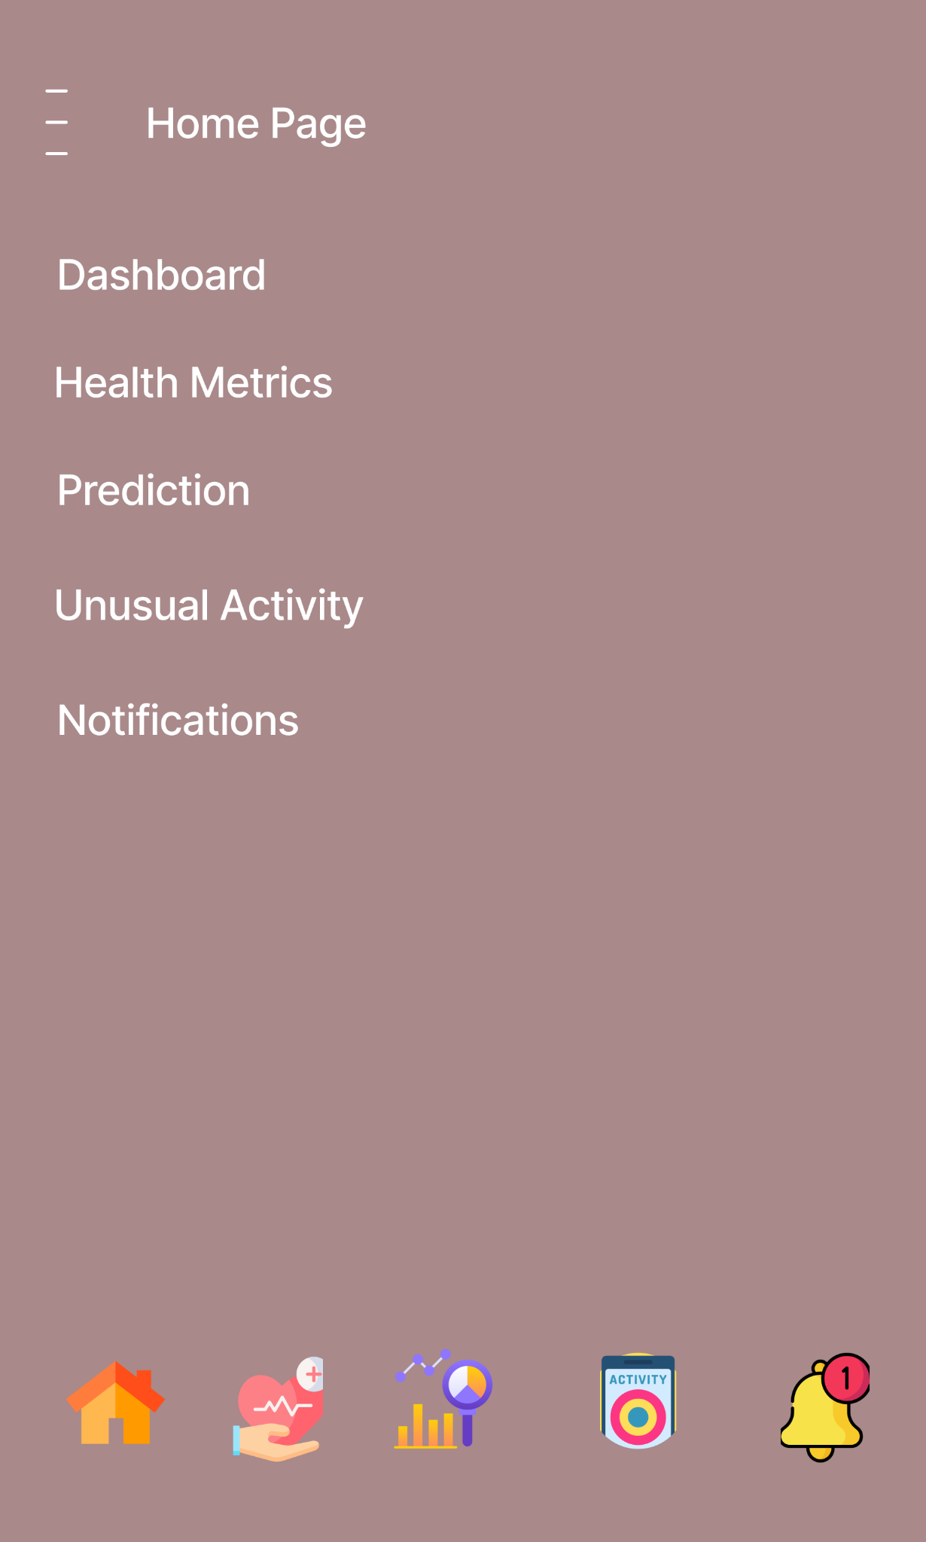
SENIOR WELLNESS APP - MVP
Step 9: Click on any option as per requirement from the above
Step 7: Login using phone no/email id and password
Step 8: Connect with smart watch
App connected with Smart Watch

Slide 29
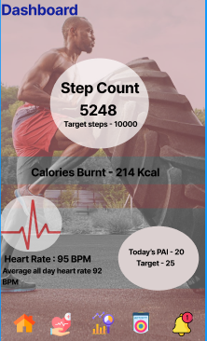
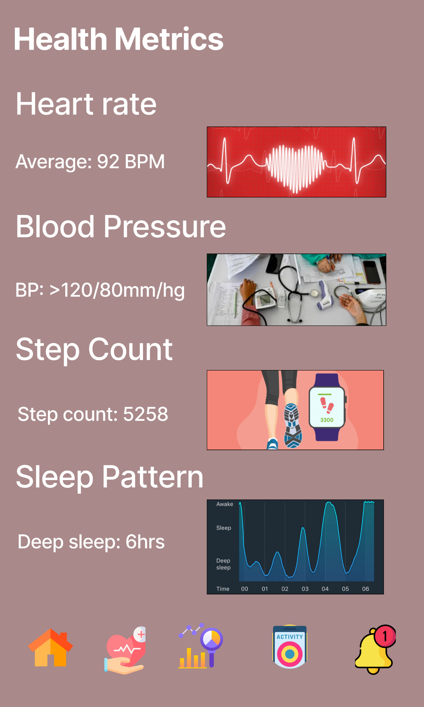
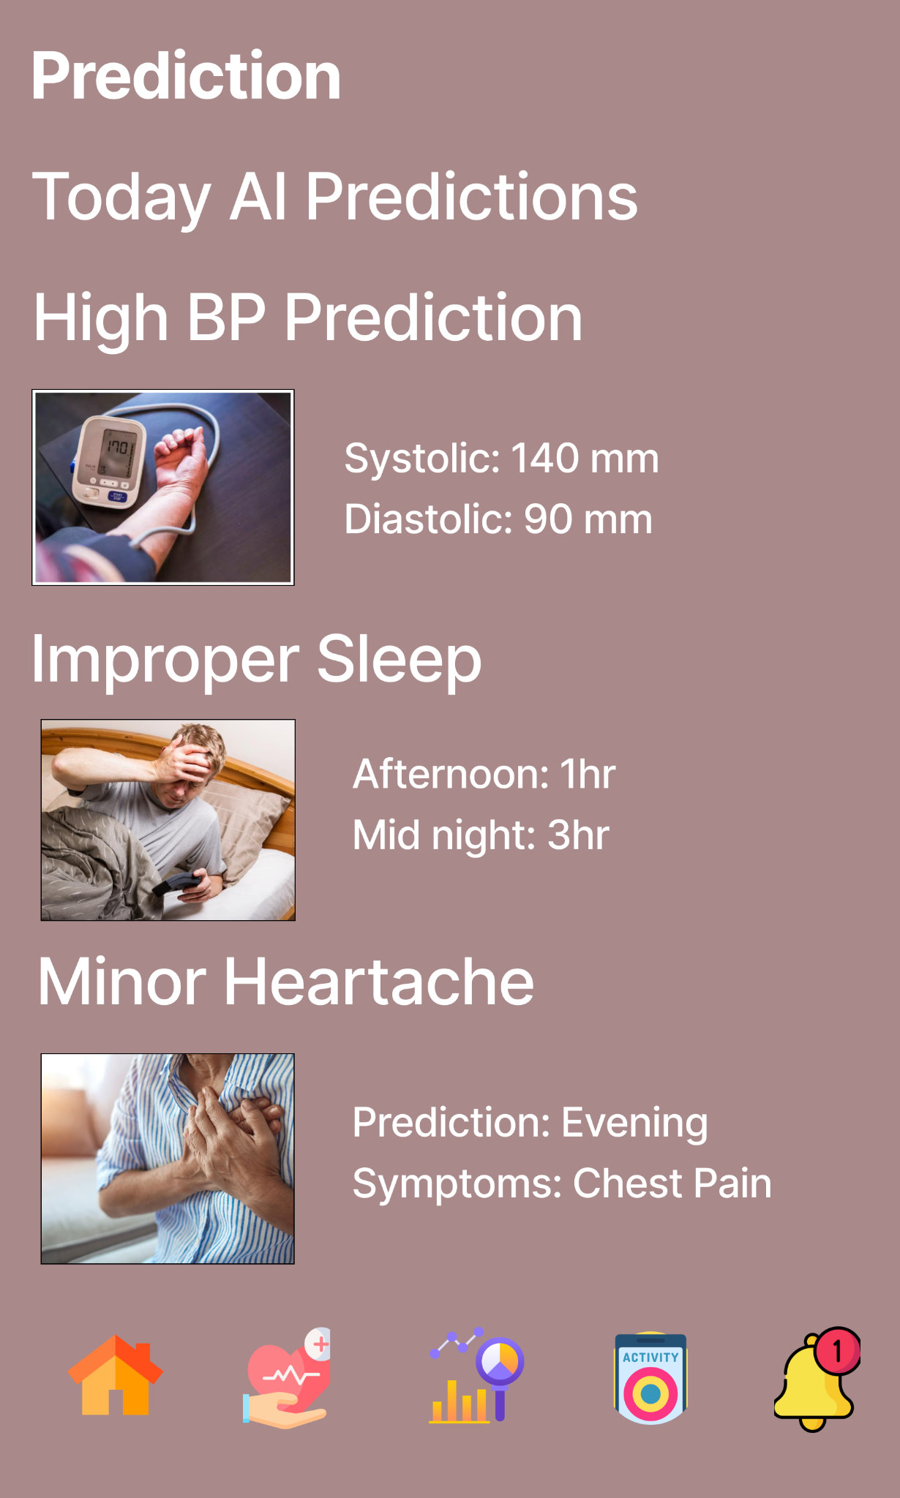
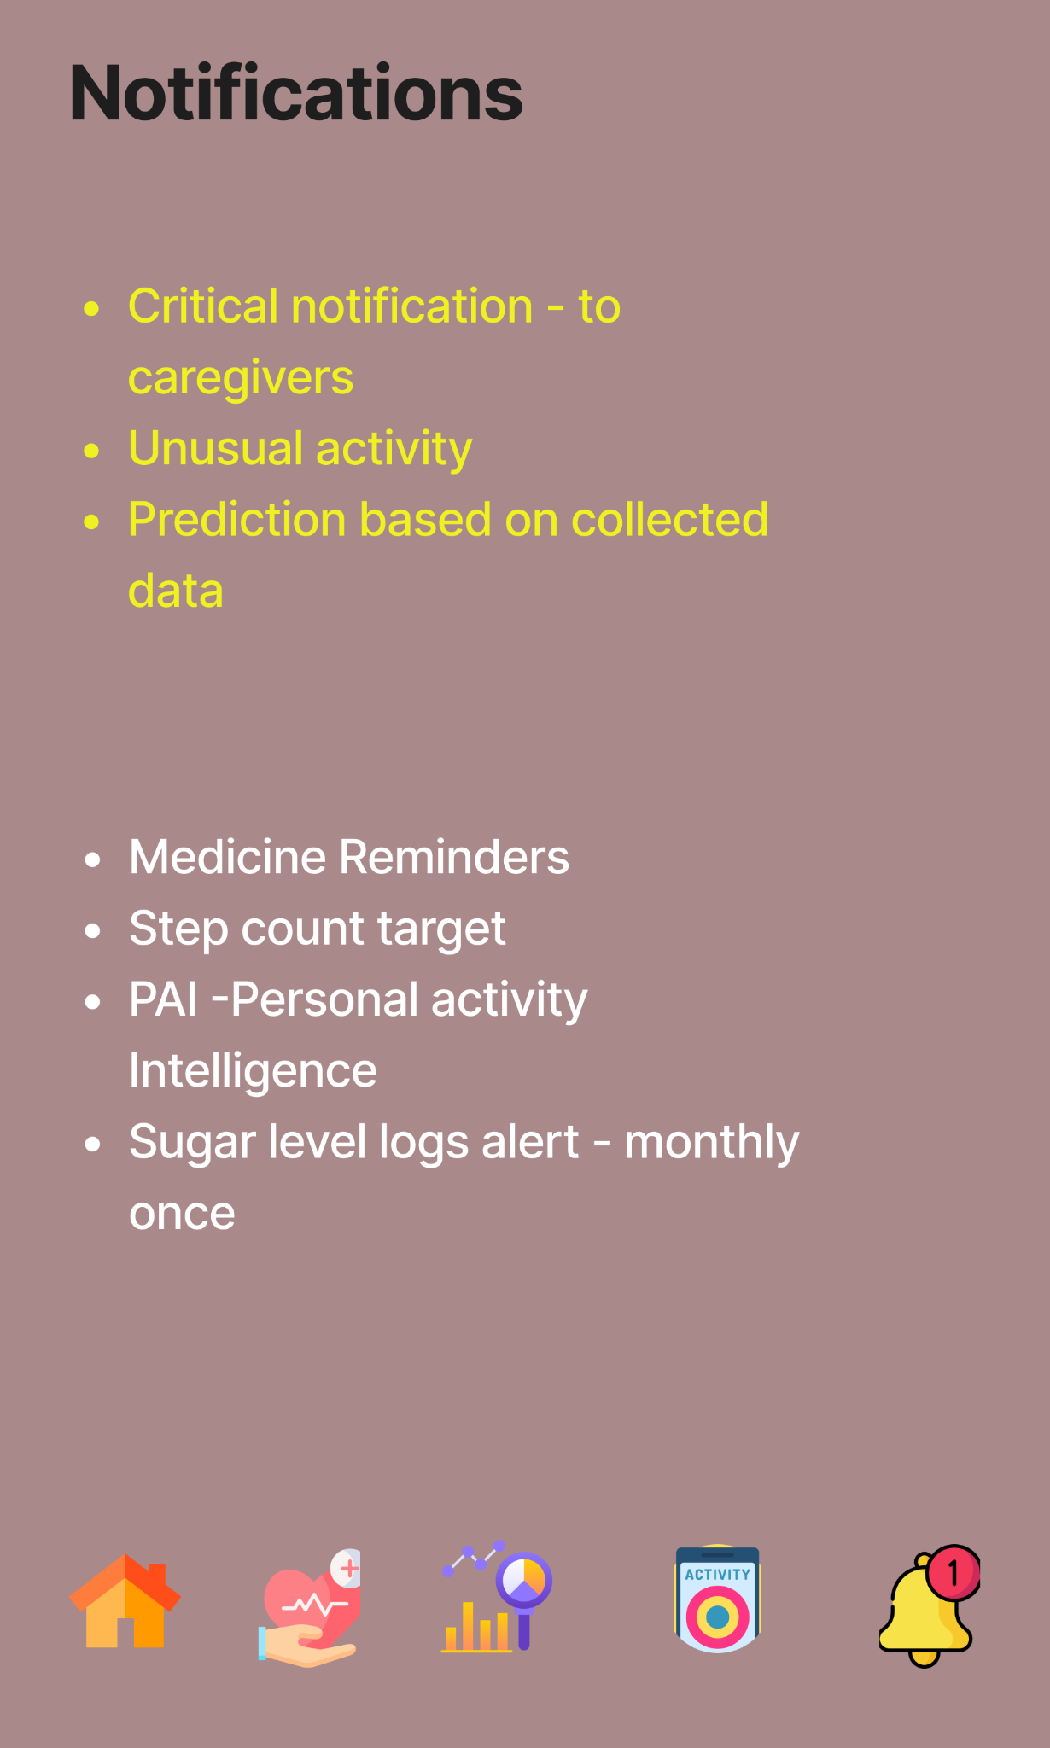
SENIOR WELLNESS APP - MVP
Step 13: Check for Notifications
Step 10: Check the Dashboard Analysis
Step 11: Check Health Metrics
Step 12: Check Predictions

Slide 30
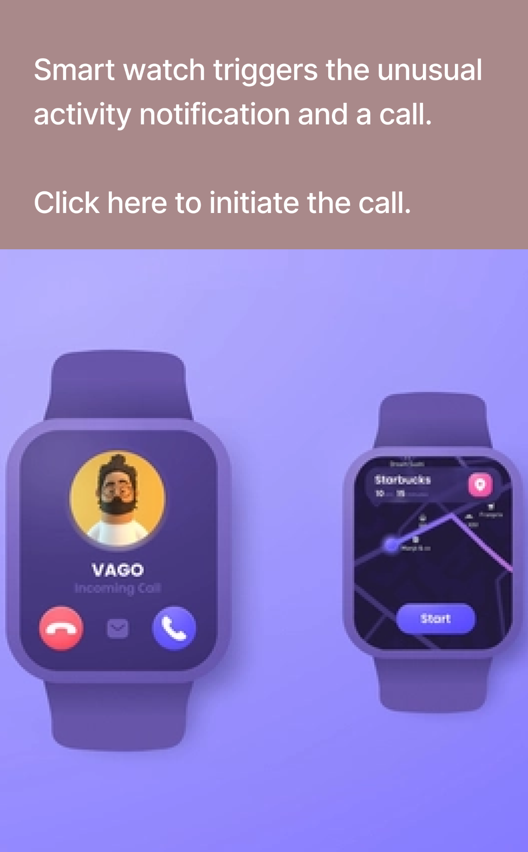
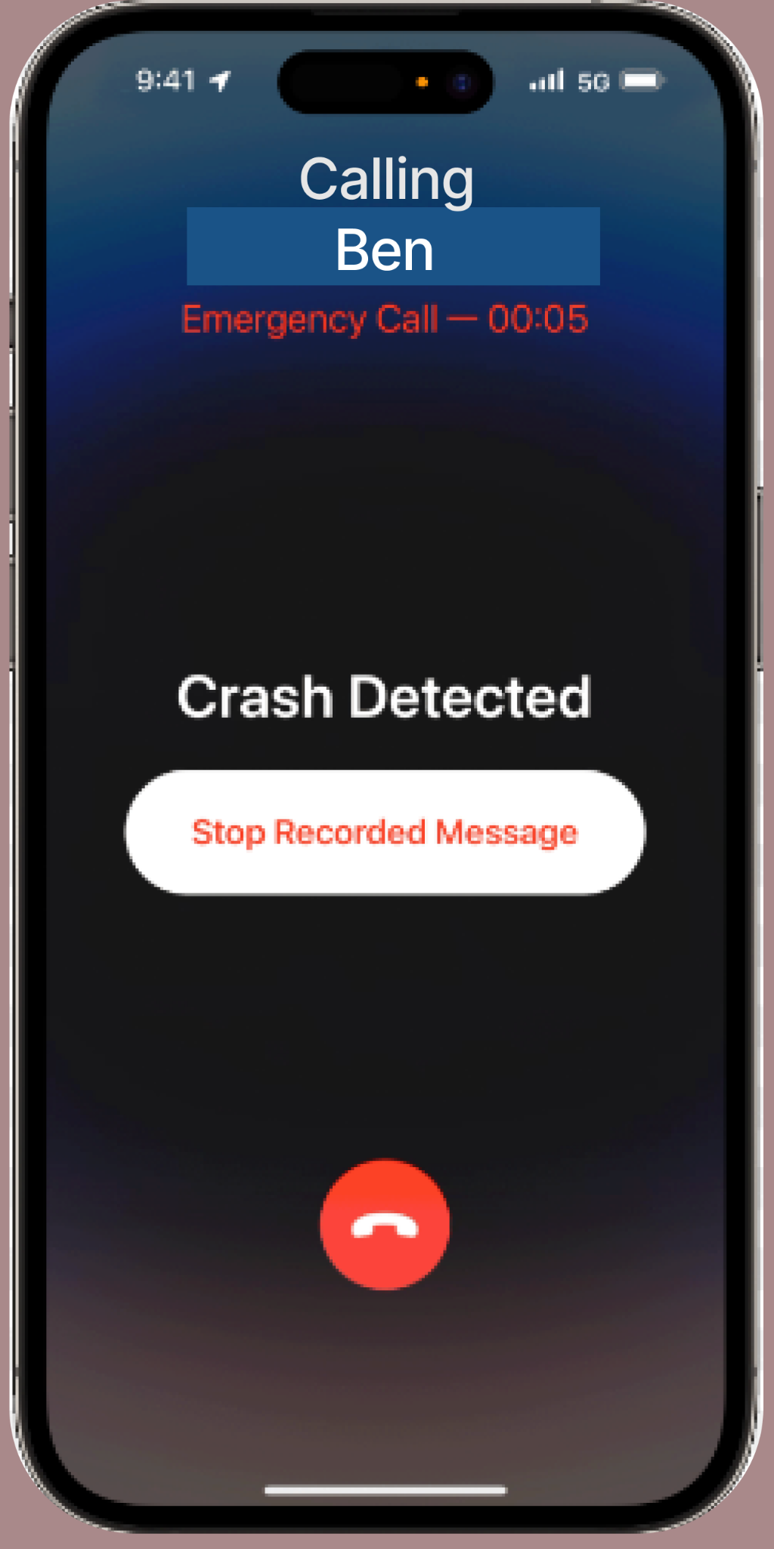
SENIOR WELLNESS APP
Step 15: Unusual activity triggered by Smart Watch
Step 16: Emergency call made by app to the caretaker of the senior citizen

Slide 31
User Feedback on MVP
USER RESPONSE - Senior Citizen
USER RESPONSE - Caretaker
The health monitoring features will be incredibly helpful. I will be able to easily track my heart rate, blood pressure, oxygen level, and daily steps with just a glance at my wrist. It will help me keep an eye on my overall health trends and remind me to stay active, which will be fantastic.
One of the best aspects will be the seamless connection it has with my daughter's phone. I know that she worries about me, especially when she's at work or away. With this smartwatch, she will receive real-time updates on my health, and I will be able to see how relieved it makes her knowing that she can keep an eye on me even from a distance.
The emergency call feature will prove to be a true lifesaver.
The real-time notifications are a game-changer. The moment there's an unusual activity, such as a fall or sudden drop in vital signs, the smartwatch sends an emergency alert to my phone. This prompt communication allows me to act swiftly and take appropriate action, whether it's contacting my parents or emergency services. It will help to prevent potential emergencies from escalating, and I am immensely grateful for that.
The user interface of the mobile app is user-friendly and straightforward. I can easily navigate through the various health metrics and check the historical data to understand any patterns. Additionally, the emergency contact settings were easy to configure, ensuring that the right people are notified during critical situations.
What if questions were asked-
What if questions were asked-
What if I forget to charge the smartwatch? Will it still be able to track my health and send emergency alerts?
What if the smartwatch gives inaccurate health readings? How can I trust its accuracy?
What if I accidentally trigger an emergency alert? How can I cancel it to avoid unnecessary responses?
What if there's a software update for the smartwatch? How will I be notified, and will it require any manual intervention?
What if the smartwatch loses Bluetooth connectivity with the phone? Will it store data locally and sync when the connection is restored?
What if I need to share my parent's health data with their doctor or healthcare provider? Does the smartwatch support data export?

Slide 32
Thanks !

